Slide 1

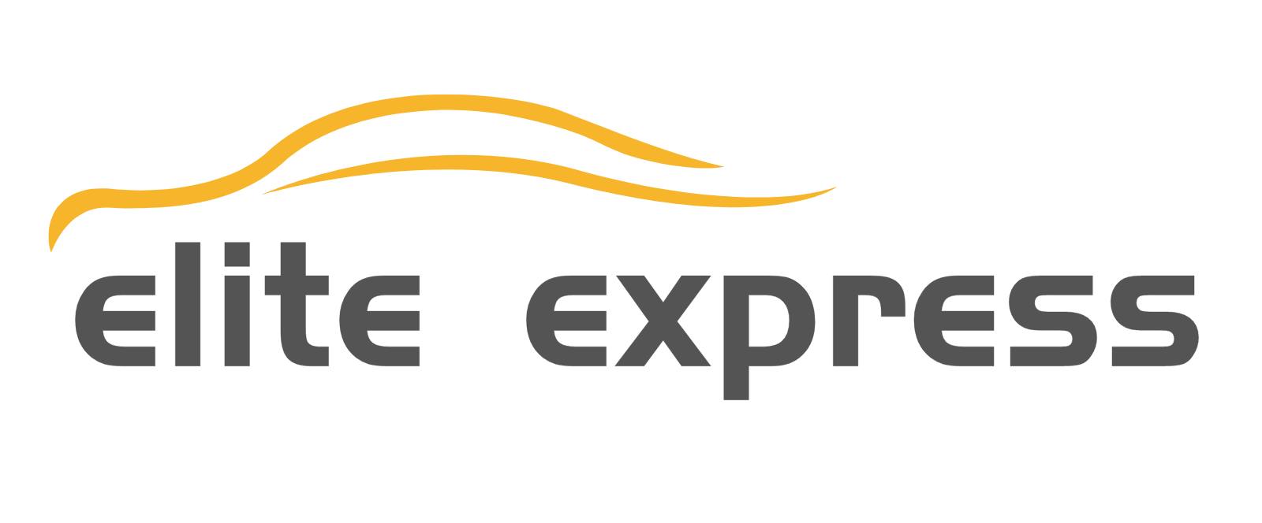

June 2025
Investor Presentation
Elite Express Holding Inc.
Issuer Free Writing Prospectus dated June 2, 2025
Filed Pursuant to Rule 433 of the Securities Act of 1933, as amended Relating to Preliminary Prospectus dated May 23, 2025
Registration Statement No. 333-286965

Slide 2

FREE WRITING PROSPECTUS STATEMENT
This free writing prospectus relates to the proposed public offering of Class A common stock of Elite Express Holding Inc. (“we”, “us”, or “our”) and should be read together with the Registration Statement on Form S-1 (File No. 333-286965) (the “Registration Statement”) we filed with the U.S. Securities and Exchange Commission (the “SEC”) for the offering to which this presentation relates and may be accessed through the following web link:
https://www.sec.gov/Archives/edgar/data/2053641/000110465925052312/tm254980d6_s1a.htm
The Registration Statement has not yet become effective. Before you invest, you should read the prospectus in the Registration Statement (including the risk factors described therein) and other documents we have with the SEC in their entirety for more complete information about us and the offering. You may get these documents for free by visiting EDGAR on the SEC website at http://www.sec.gov.
Alternatively, we or our underwriter will arrange to send you the prospectus if you contact Dominari Securities LLC via email at info@dominarisecurities.com, or contact Elite Express Holding Inc. via email: info@eliteexpressholding.com.
This presentation shall not constitute an offer to sell, or the solicitation of an offer to buy, nor will there be any sale of these securities in any state or other jurisdiction in which such offer, solicitation or sale would be unlawful prior to the registration or qualification under the securities laws of such state or jurisdiction. The offering will only be made by means of a prospectus pursuant to a registration statement that is filed with the SEC after such registration statement becomes effective.
See offering documents for further risks and disclosures. There is no guarantee that any specific outcome will be achieved. Investments may be speculative and illiquid and there is a risk of loss.
2

Slide 3
DISCLAIMER
This presentation contains “forward-looking statements” within the meaning of the Private Securities Litigation Reform Act and other securities laws. All statements contained in this presentation other than statements of historical fact, including statements regarding our future results of operations and financial position, our business strategy and plans, and our objectives for future operations, are forward-looking statements. The words “believe,” “may,” “will,” “estimate,” “continue,” “anticipate,” “intend,” “expect,” and similar expressions and the negatives of those terms are intended to identify forward-looking statements. We have based these forward-looking statements largely on our management’s current expectations and projections about future events and trends that we believe may affect our financial condition, results of operations, business strategy, short-term and long-term business operations and objectives, and financial needs. These forward-looking statements are subject to a number of risks, uncertainties and assumptions, and other factors, which could cause our actual results, performance or achievements to differ materially from expected future results, performance or achievements expressed or implied in those forward-looking statements. Examples of these forward-looking statements and the related risks, uncertainties and other factors include, but are not limited to, the success and timing of our commercialization activities, including our ability to grow our business; our ability to successfully compete with competitors; our ability to expand our business to new business lines and segments, our ability to execute our acquisition-driven growth strategy; the scalability of our technology infrastructure; future demand for last-mile delivery services; and our dependence on FedEx. Moreover, we operate in a competitive and rapidly changing environment. New risks emerge from time to time. It is not possible for our management to predict all risks, nor can we assess the impact of all factors on our business or the extent to which any factor, or combination of factors, may cause actual results to differ materially from those contained in any forward-looking statements we may make. In light of these risks, uncertainties and assumptions, the future events and trends discussed in this presentation may not occur and actual results could differ materially and adversely from those anticipated or implied in the forward-looking statements.
Forward-looking statements are provided to allow potential investors the opportunity to understand management’s beliefs and opinions in respect of the future so that they may use such beliefs and opinions as one factor in evaluating an investment. These statements are not guarantees of future performance and undue reliance should not be placed on them. Any forward-looking statement in this presentation, in any related presentation supplement and in any related free writing presentation reflects our current view with respect to future events and is subject to these and other risks, uncertainties and assumptions relating to our business, results of operations, industry and future growth. You should read this presentation with the understanding that our actual future results may be materially different from any future results expressed or implied by these forward-looking statements. Except as required by law, we assume no obligation to update or revise these forward-looking statements for any reason, even if new information becomes available in the future.
This presentation provides basic information about our company and the offering. Because it is only a summary, this presentation does not cover all the information that should be considered before investing. You should read carefully the factors described in the “Risk Factors” section of our Registration Statement to better understand the risks and uncertainties in our business and any forward-looking statements.
See offering documents for further risks and disclosures. There is no guarantee that any specific outcome will be achieved. Investments may be speculative and illiquid and there is a risk of loss.
3

Slide 4
OFFERING SUMMARY
ISSUER: | Elite Express Holding Inc.
PROPOSED EXCHANGE AND SYMBOL: | Nasdaq Capital Market: ETS
EXPECTED OFFERING SIZE: | 4,000,000 shares of Class A common stock (excluding 15% over-allotment option)
EXPECTED OFFERING PRICE : | $4.00 per share
OFFERING TYPE: | Initial Public Offering
SECURITIES OFFERED: | Class A common stock
ANTICIPATED USE OF PROCEEDS: | Approximately 60% for equity acquisitions, asset acquisitions, and other strategic investments in businesses providing the ground transportation services; Approximately 30% for upgrading our fleet, including transitioning to electric vehicles and integrating advanced technology ; Approximately 5% for development and ongoing maintenance of a mobile application designed to connect drivers with businesses requiring route-based services; and Approximately 5% for working capital and general corporate purposes
JOINT BOOK-RUNNING MANAGERS: | Dominari Securities LLC and Revere Securities LLC
See offering documents for further risks and disclosures. There is no guarantee that any specific outcome will be achieved. Investments may be speculative and illiquid and there is a risk of loss.
4

Slide 5
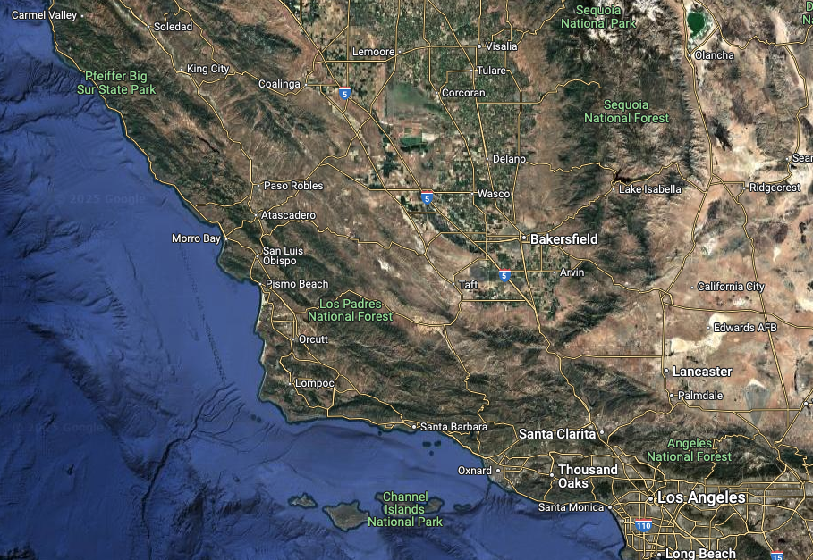
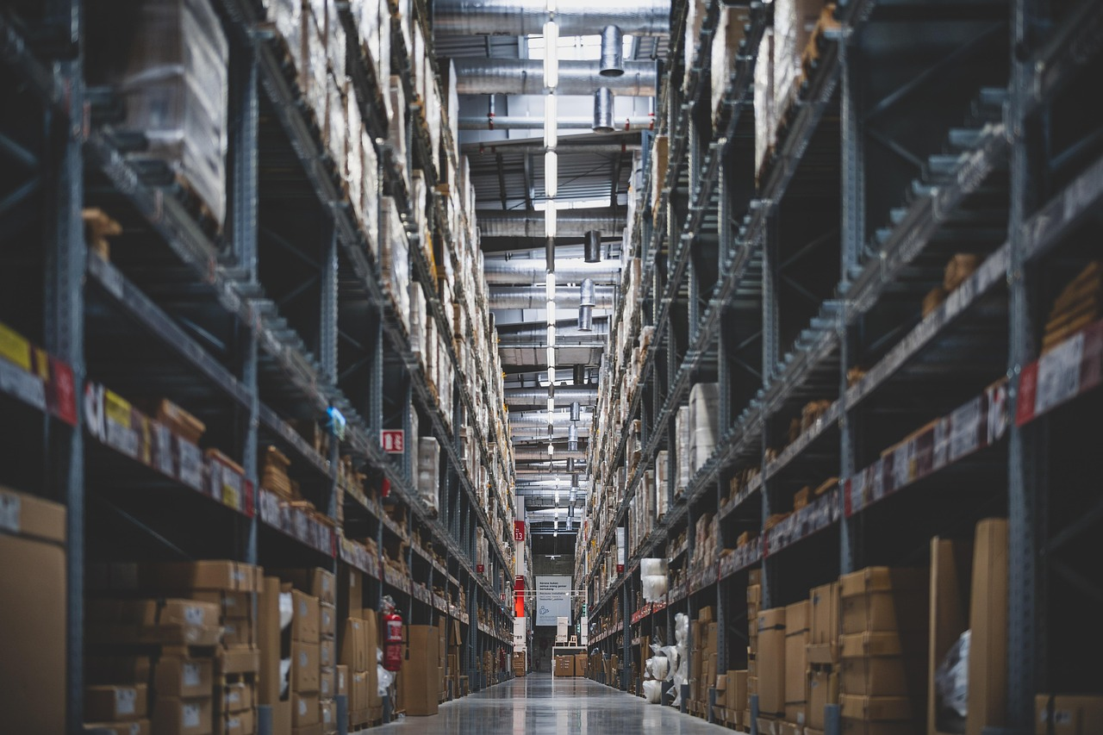
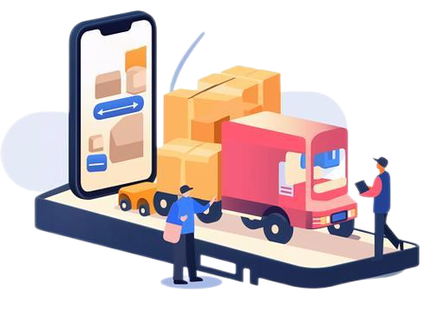
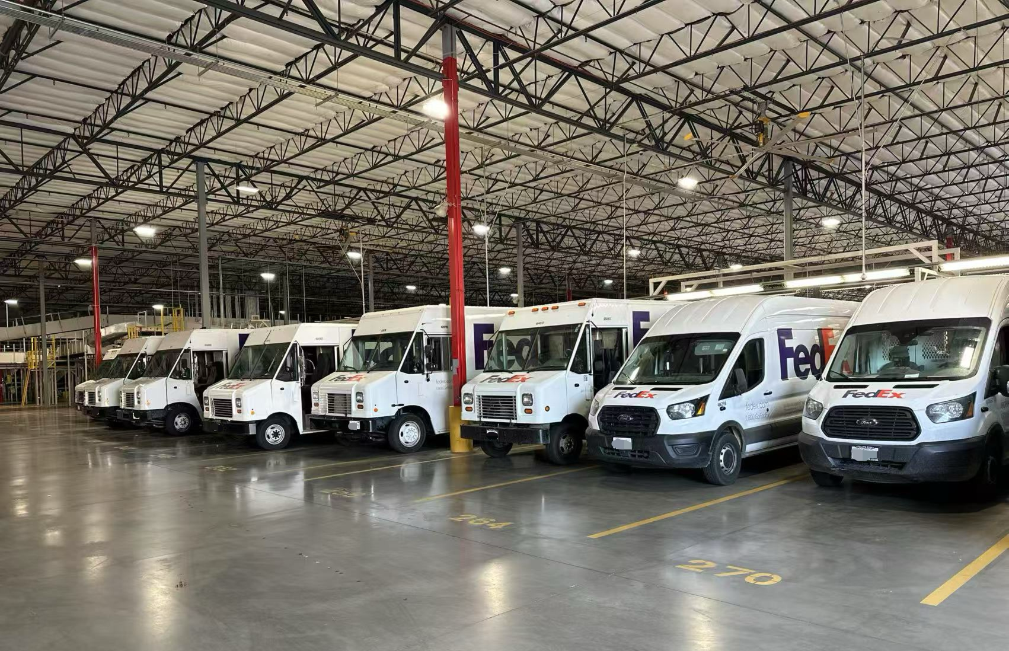
COMPANY OVERVIEW
Our mission is to optimize last-mile logistics by providing efficient, reliable, and innovative delivery solutions.
We currently specialize in last-mile delivery services within California:
Square Miles Currently Served
1,665.28 sq. mi.
Retrieving packages from distribution hubs (currently Fedex), and
Ensuring their prompt and secure delivery to recipients’ doorsteps.
Peak Daily Packages & Stops
2,000+
Commercial Fleet
20+
See offering documents for further risks and disclosures. There is no guarantee that any specific outcome will be achieved. Investments may be speculative and illiquid and there is a risk of loss.
5

Slide 6






INVESTMENT HIGHLIGHTS
Seeking to grow through acquisition of businesses providing the ground transportation services throughout the regions given our capabilities and the competitive landscape:
Highly competitive sector, consisting of several large and many small service providers. Small, privately-owned and managed operations may lack the resources to grow beyond their existing territories
Successful relationship with Fedex that provides stable and predictable revenue with weekly cash settlement that facilitates cashflow
Ability to leverage logistics software to reduce costs by optimizing routing, driver compliance, and safety management
Experienced management team with average of 10+ years’ experience in logistics and operations
Internal focus on service quality and latest safety standards
to maintain reliability across the network
See offering documents for further risks and disclosures. There is no guarantee that any specific outcome will be achieved. Investments may be speculative and illiquid and there is a risk of loss.
6

Slide 7



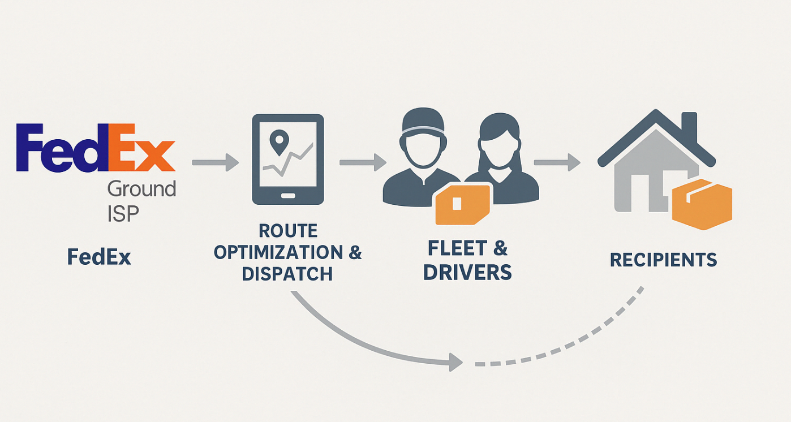
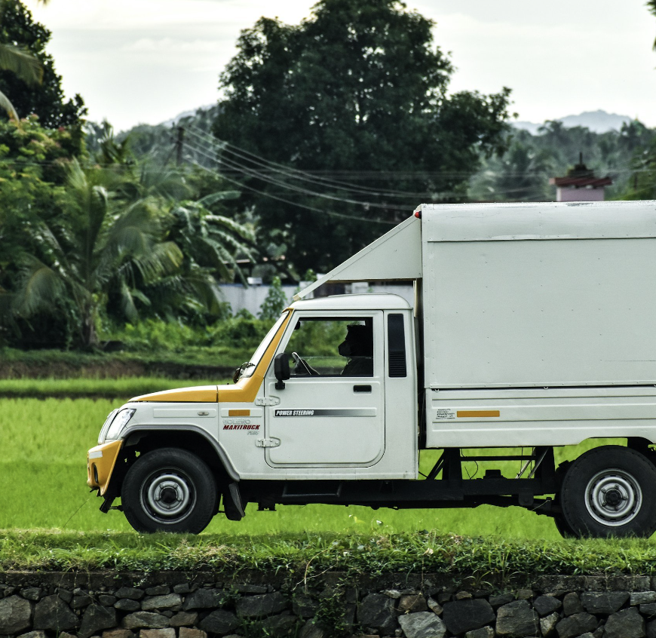


OUR SERVICES
Route Optimization
Use GroundCloud for daily route planning, driver dispatch, and real-time adjustments
Package Pickup
Package Delivery
Collect packages from FedEx-assigned locations; follow strict loading & safety protocols
Drivers independently deliver to homes & businesses using GPS and navigation tools
Analyze logs on stops, drive time, and delivery accuracy; Handle FedEx feedback & retrain if needed
Post-Delivery
See offering documents for further risks and disclosures. There is no guarantee that any specific outcome will be achieved. Investments may be speculative and illiquid and there is a risk of loss.
7

Slide 8
INDUSTRY CHARACTERISTICS
Success in the last mile route delivery industry requires
several critical strategic and tactical capabilities
Operational success depends on advanced tools like route optimization, real-time tracking, and automated dispatching, along with continuous upgrades and training
Compliance with transportation, safety, and data privacy regulations at multiple levels can be both complex and
costly
Meeting rising customer expectations while maintaining margins remains an industry-wide challenge
Strategic leadership is essential to scale operations and adapt to shifting market conditions
Building an efficient logistics operation requires ongoing investment in personnel, fleet, software, and regulatory compliance
Substantial time and capital investment
Technology is a competitive necessity
Challenging regulatory environment
Balancing service quality and cost
Need for effective management
See offering documents for further risks and disclosures. There is no guarantee that any specific outcome will be achieved. Investments may be speculative and illiquid and there is a risk of loss.
8

Slide 9






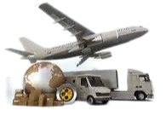
COMPETITIVE FACTORS
We believe the route delivery industry is highly competitive, with key factors including:
Technology
adoption
Financial
scale
AI-powered routing and
real-time tracking are
becoming industry standards
Some entrants like Uber Eats and DoorDash are very large
and have far greater capital
and resources
Regional specialization
Service quality
Speed, reliability, and
consistency are critical to customer retention
Niche players thrive by focusing on specific verticals or local needs
Competitive Factors
Price sensitivity
Seasonal demand pressure
Low switching costs lead to
intense price competition
among service providers
Peak seasons require scalable operations and flexible resource allocation
See offering documents for further risks and disclosures. There is no guarantee that any specific outcome will be achieved. Investments may be speculative and illiquid and there is a risk of loss.
9

Slide 10
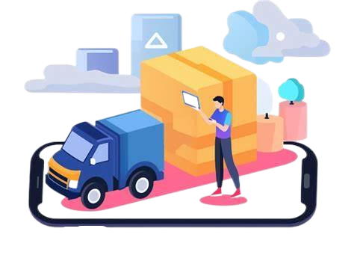

GROWTH STRATEGY
[UW to confirm and input.]
Strengthening last-mile delivery through acquisition/scale expansion, cost optimization, and technological innovation
Technology & Automation
Develop AI-powered logistics tools for route optimization and predictive maintenance
Gradually integrate autonomous vehicle solutions to reduce costs and improve scalability
Leverage data and analytics for fleet utilization and operational decision-making
Expansion of Delivery Routes
Expand FedEx-designated delivery routes, especially in high-volume suburban/urban zones
Pursue new contracts with e-commerce platforms and retailers
Explore entry into long-haul logistics to complement last-mile network
Eco-friendly Transition
Transition to electric vehicles to lower fuel costs and carbon footprint
Leverage EV tax incentives and reduced maintenance costs to enhance ROI
Strengthen brand appeal to eco-conscious customers and enterprise partners
Our Steps:
Operational Optimization
Adopt flexible staffing + data-driven scheduling to manage peak demand
Invest in financial and workforce systems to control costs and support growth
Implement retention programs to reduce driver turnover and maintain service quality
See offering documents for further risks and disclosures. There is no guarantee that any specific outcome will be achieved. Investments may be speculative and illiquid and there is a risk of loss.
10

Slide 11


GROWTH STRATEGY
Growth potential via acquisition/scale expansion
The last-mile delivery market in California is fragmented, with many small courier and delivery companies operating independently. In California alone, there are over 4 million small businesses, many of which include regional delivery operators. The workforce is composed of gig workers, offering flexibility but often lacking the capital, technology, or structure to upscale—making the region conducive to a roll-up strategy.
Significant Fragmentation
Among Small Operators
E-Commerce Market
Success Requires Cost- Efficient Operations
The U.S. e-commerce market is projected to reach $1.34 trillion by 2025, with a CAGR of 8.22% between 2025 and 2029. This sustained growth continues to fuel demand for efficient last-mile delivery services.
Statista, Ecommerce Report: United
States, 2024.
Shipping represents 90% of total order fulfillment costs, and last-mile delivery is the most expensive and complex component, placing high value on efficient local delivery networks.
Statista, E-commerce Logistics
in the U.S., 2024.
California is home to over 4.1 million small businesses, accounting for 99.8% of all businesses in the state. Many operate in transportation, delivery, or courier services at subscale levels.
U.S. Small Business Administration, 2023 Small Business Profile – California.
See offering documents for further risks and disclosures. There is no guarantee that any specific outcome will be achieved. Investments may be speculative and illiquid and there is a risk of loss.
11

Slide 12
IMPACT OF IPO PROCEEDS
Approximately 60% for equity acquisitions, asset acquisitions, and other strategic investments in businesses providing the ground transportation services
Initial JAR acquisition in October 2024 cost approximately $1.4 million; majority of the IPO proceeds are expected to be used to support potential acquisition activity
$8.4 million
Approximately 20 vehicles acquired in JAR transaction; proceeds will fund fleet renovation and increase in fleet size. Electric vehicles are expected to become a significant part of the fleet composition
Approximately 30% for upgrading our fleet, including transitioning to electric vehicles and integrating advanced technology
$4.2 million
Approximately 5% for development and ongoing maintenance of a mobile application designed to connect drivers with businesses requiring route-based services
Proceeds will support development of this platform, which is intended to streamline matching between drivers and commercial delivery needs
$0.7 million
Working capital at February 28, 2025 was approximately $42,000. Additional funding will assist in growth of current business and provide working capital for any acquired businesses
Approximately 5% for working capital and general corporate purposes
$0.7 million
See offering documents for further risks and disclosures. There is no guarantee that any specific outcome will be achieved. Investments may be speculative and illiquid and there is a risk of loss.
12

Slide 13



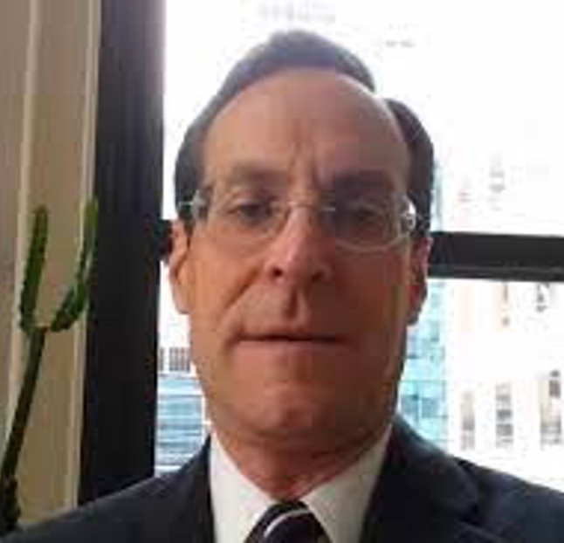
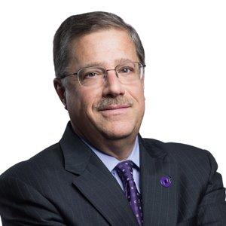
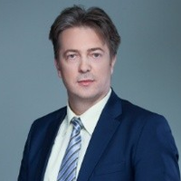
OUR BOARD & MANAGEMENT TEAM
[UW to confirm and input.]
  Tony Liu
Yidan Chen
Robert Cook
Adam Eilenberg
Francis A. Braun III
Ninoslav Vasic
Chairman of the Board of Directors
Chief Executive Officer, President, and Director
Chief Financial Officer
Independent
Director
Independent
Director
Independent
Director
Mr. Liu has served as our Chairman since June 2024. He is also the founder and CEO of Cheetah Net (Nasdaq: CTNT) and has extensive experience in business development, investor relations, and corporate administration. Mr. Liu holds a Master’s in Finance from Brandeis University and a Bachelor’s in Finance and Law from Harbin Engineering University.
Ms. Chen has served as our CEO, President, and Director since January 2025. She has over 25 years of experience in investment management and executive leadership across the U.S. and China. She holds a Bachelor’s degree from Southwest Agricultural University.
Mr. Cook has served as our CFO since November 2024. He has deep experience in SEC reporting, public company finance, and investor relations. He previously served as CFO of CTNT and CorMedix (Nasdaq: CRMD). He holds a Bachelor’s in International Finance from American University.
Mr. Eilenberg is the managing partner at Eilenberg & Krause LLP and has practiced corporate and securities law for over 40 years. He previously served as an independent director of CTNT and holds a Juris Doctor from Harvard Law School.
Mr. Braun is a financial consultant and director at Crown Bank, and formerly a partner at Grant Thornton LLP. He has extensive experience in finance, accounting, and corporate governance. He holds a Bachelor’s in Accounting from Rider University.
Mr. Vasic is CEO of Golden Consultancy Inc. and has a background in project management and financial planning & analysis, business process management, financial management and strategy development.. He formerly held leadership roles at Credit Agricole Banking Group. He holds an MBA from Cotrugli Business School and a Bachelor’s in Economics from the University of Belgrade.
See offering documents for further risks and disclosures. There is no guarantee that any specific outcome will be achieved. Investments may be speculative and illiquid and there is a risk of loss.
13

Slide 14
SELECTED FINANCIALS
[UW to confirm and input.]
See offering documents for further risks and disclosures. There is no guarantee that any specific outcome will be achieved. Investments may be speculative and illiquid and there is a risk of loss.
14

Slide 15
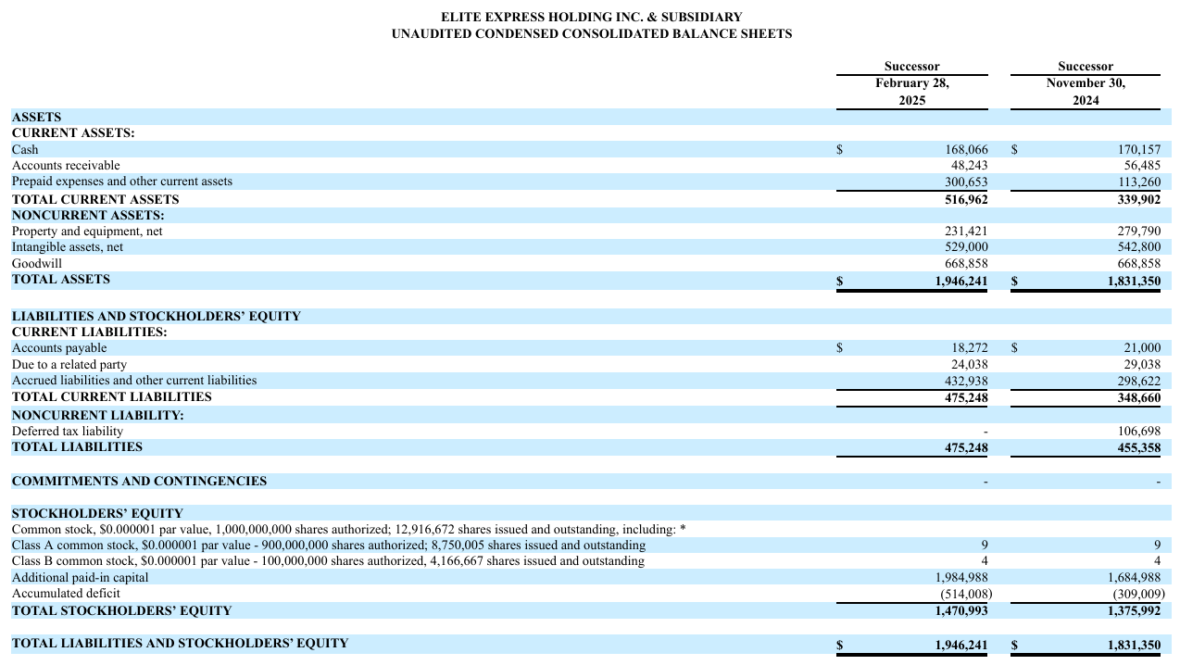
BALANCE SHEETS
[UW to confirm and input.]
See offering documents for further risks and disclosures. There is no guarantee that any specific outcome will be achieved. Investments may be speculative and illiquid and there is a risk of loss.
15

Slide 16
CONTACT
FOR QUESTIONS, PLEASE CONTACT:
Elite Express Holding Inc.
23046 Avenida De La Carlota, Suite 600
Laguna Hills, CA 92653
Dominari Securities LLC
725 Fifth Avenue, 23rd Floor
New York, NY 10022
info@dominarisecurities.com
Revere Securities LLC
560 Lexington Ave, 16B
New York, NY 10022
contact@reveresecurities.com
All ideas contained within this document are owned by Elite Express Holding Inc.

